Slide 1
L515 Calibration & Alignment

Slide 2
Read out values
In cmd window: cd C:\Program Files (x86)\Intel RealSense SDK 2.0\tools
rs-enumerate-devices –c

Slide 3
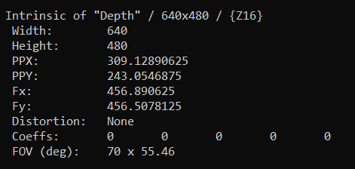
Intrinsic values (1) Depth
Intrinsic of "Depth" / 640x480 / {Z16}
Width: 640
Height: 480
PPX: 309.12890625
PPY: 243.0546875
Fx: 456.890625
Fy: 456.5078125
Distortion: None
Coeffs: 0 0 0 0 0
FOV (deg): 70 x 55.46

Slide 4
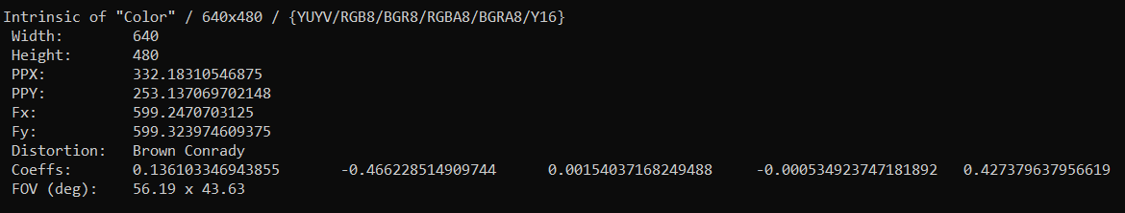
Intrinsic values (2) Color 640 x 480
Width: 640
Height: 480
PPX: 332.18310546875
PPY: 253.137069702148
Fx: 599.2470703125
Fy: 599.323974609375
Distortion: Brown Conrady
Coeffs: 0.136103346943855 -0.466228514909744 0.00154037168249488 -0.000534923747181892 0.427379637956619
FOV (deg): 56.19 x 43.63

Slide 5
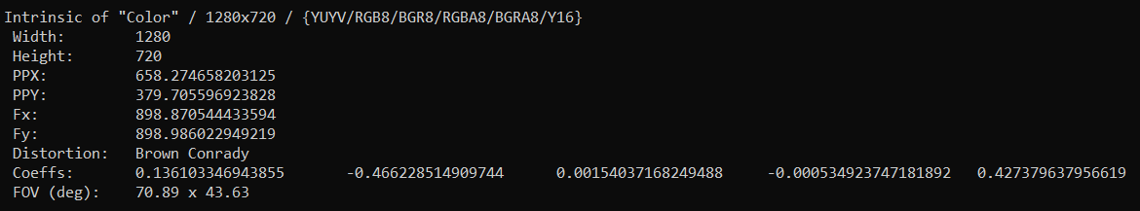
Intrinsic values (3) Color 1280 x 720
Width: 1280
Height: 720
PPX: 658.274658203125
PPY: 379.705596923828
Fx: 898.870544433594
Fy: 898.986022949219
Distortion: Brown Conrady
Coeffs: 0.136103346943855 -0.466228514909744 0.00154037168249488 -0.000534923747181892 0.427379637956619
FOV (deg): 70.89 x 43.63

Slide 6
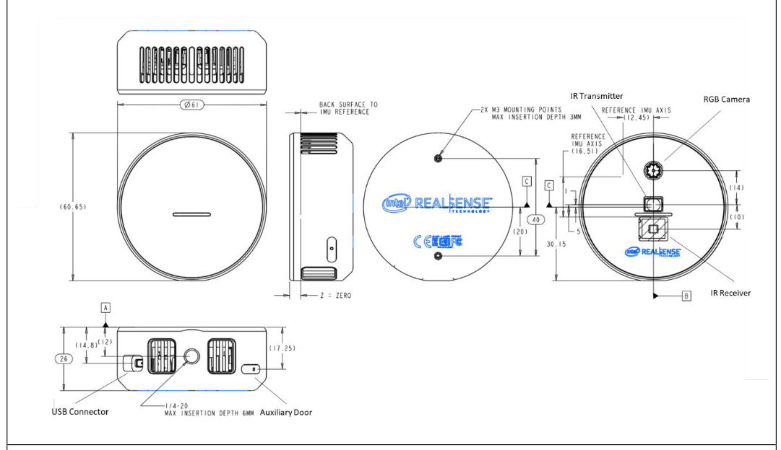
Drawing

